Slide 1

Part 3.1 Network Analysis of Personal Genomes
James Diao, Zhaolong Yu, and Dingjue Ji
Yale University
9 May 2017

Slide 2
overview
Introduction to protein networks
Computing measures of centrality for gene sets
Using Cytoscape for network visualization and hierarchical analysis

Slide 3
1 | Introduction to protein networks

Slide 4
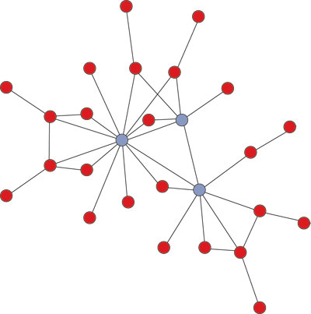
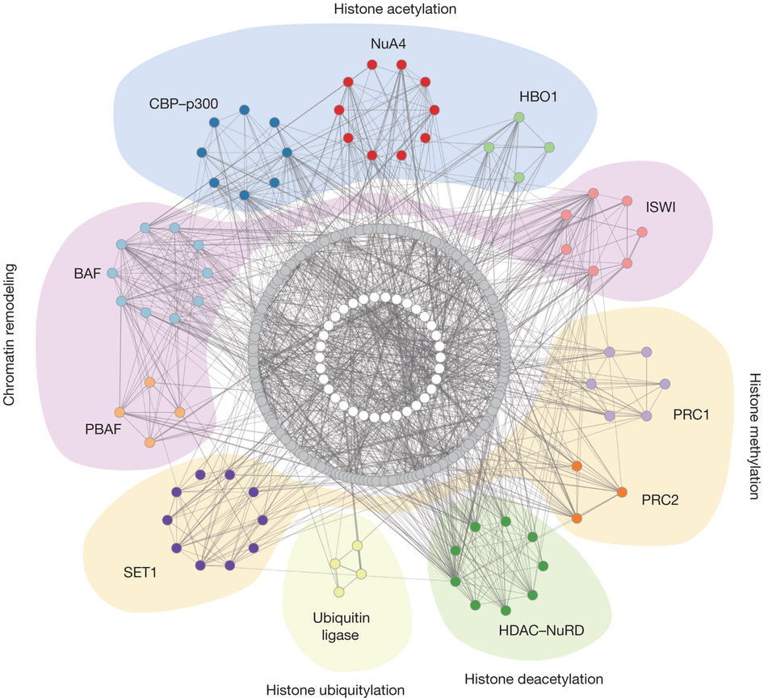
Network theory
Node: individual protein
Edge: evidence of interaction
Degree centrality: normalized number of edges connected to a node.
Betweenness centrality: normalized number of times a node is within the shortest path between two other nodes.
Hierarchical networks: separates a network into nested sub-networks.
Notes:
In the theory of protein-protein interaction (PPI) networks, each protein is considered to be a node. Evidence of interaction is encoded as an edge between two nodes.
These centralities measurement allow us to quantitatively show the influence of an individual gene on the overall network. Genes that are connected to many nodes, or help to connect other nodes are of special interest. This is because their removal may affect a large number of other proteins and result in a more harmful mutation phenotype. We can look at which genes are affected by mutations of interest, and therefore extrapolate effects on the network at large. Thus, these measures are useful for understanding, identifying, and validating candidate mutations in the context of the whole the protein-protein network.

Slide 5
2 | Computing Measures of Centrality for Gene Sets

Slide 6
Python Script for Computing Centrality Measures
USAGE: python3 centrality_calculation.py –i <input file> -a <annotation file> -n <dip ppi file>
EXAMPLE: python3 centrality_calculation.py –i input.txt -a map_table.txt –n dip.txt
INPUT FILE: Z.3DStruct_annotation.txt
ANNOTATION FILE: From uniprot id (e.g., P62161) to gene name (e.g., Calm1)
DIP PPI file: downloaded online; provided in package
Notes:
We have created a script for computing the (1) degree centrality and (2) betweenness centrality of proteins in (A) proteins with Carl’s SNPs and (B) proteins without Carl’s SNPs. Data was collected from the DIP database including 4,679 proteins.

Slide 7
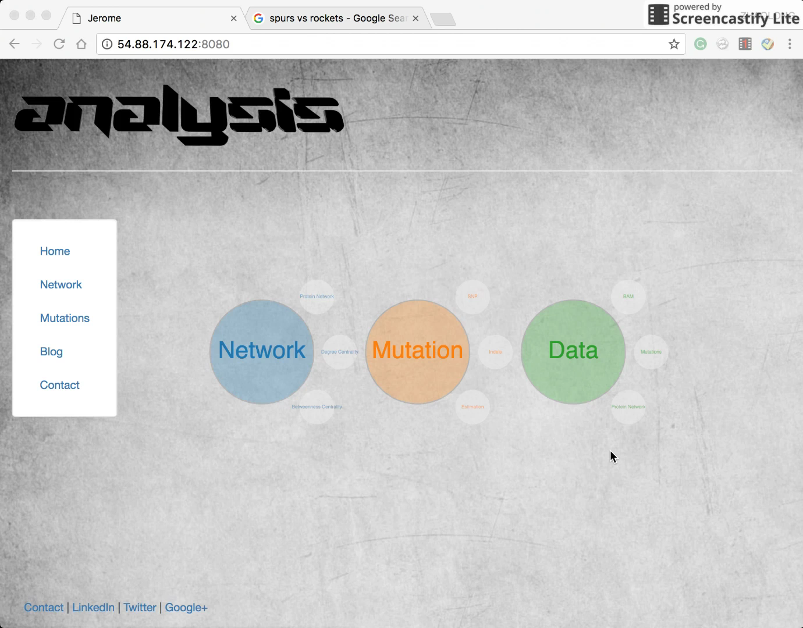
Online Analysis Tool
Notes:
It is clear that proteins with SNPs are shifted left on both measures of centrality, meaning that they are both less likely to be connected to many other nodes, and less likely to help connect other nodes.

Slide 8
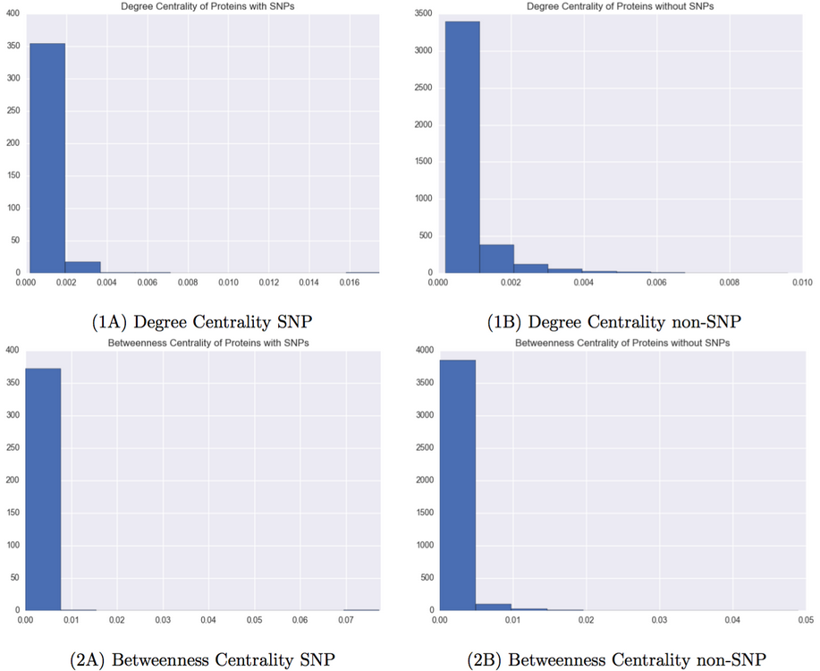
Results from Our Tool
Notes:
It is clear that proteins with SNPs are shifted left on both measures of centrality, meaning that they are both less likely to be connected to many other nodes, and less likely to help connect other nodes.

Slide 9
3 | Using Cytoscape for network visualization and hierarchical analysis

Slide 10
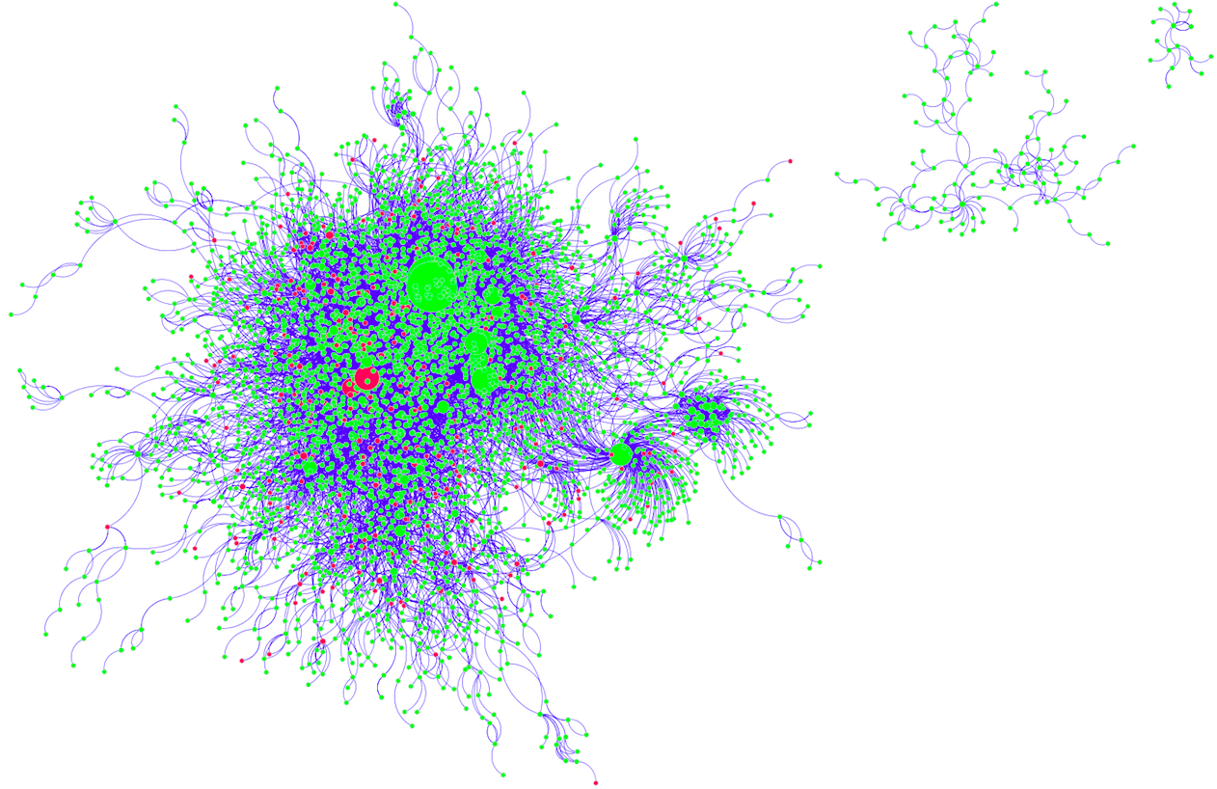
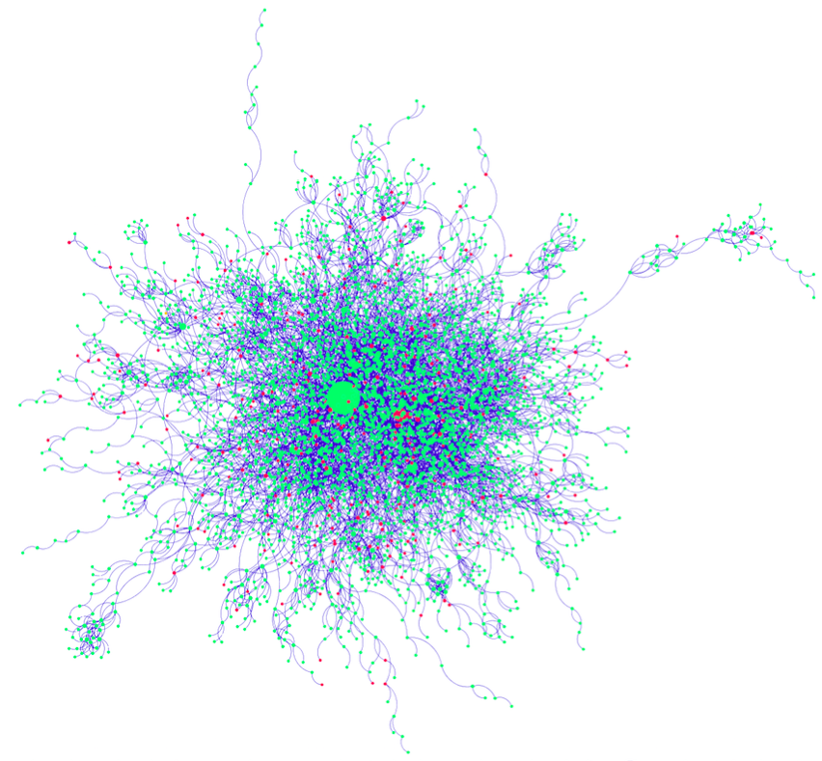
Network Visualization
DIP
MINT
Notes:
We have chosen to use Cytoscape to visualize the protein-protein network. In each plot, the genes with Carl’s SNPs are marked in red, and the genes without SNPs are marked in green. The node size is proportional to its degree.

Slide 11
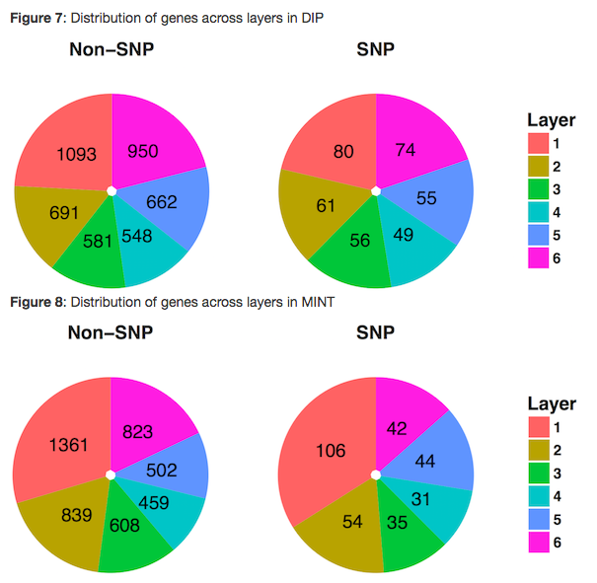
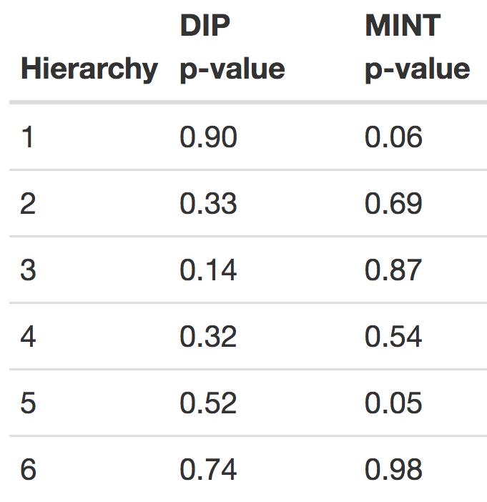
Hierarchical Analysis
Notes:
Hierarchical network analysis was performed to look for enrichment or depletion of mutations in different hierarchies. Although the interactomes DIP and MINT do not have regulatory relationship recorded, it might still be useful to check the hierarchy in network structure like directed graphs. The goal is to separate the graph in a hierarchy. However, I did not find any available tools to use or algorithms to implement on undirected graphs for hierarchical analysis. Note that, HirNet by Cheng C et al. is designed for directed network, but here we use it to catch a glimpse of the network structure. It does not necessarily reflect any regulatory features for the network itself. Fisher’s exact test was used to test for enrichment of SNPs in each hierarchical layer.

Slide 12
Summary
SNP genes have lower influence on the overall protein network
Network visualization reveals individual genes that are more likely to be pathogenic
Hierarchical analysis did not demonstrate significant SNP enrichment in any layer

